Slide 1

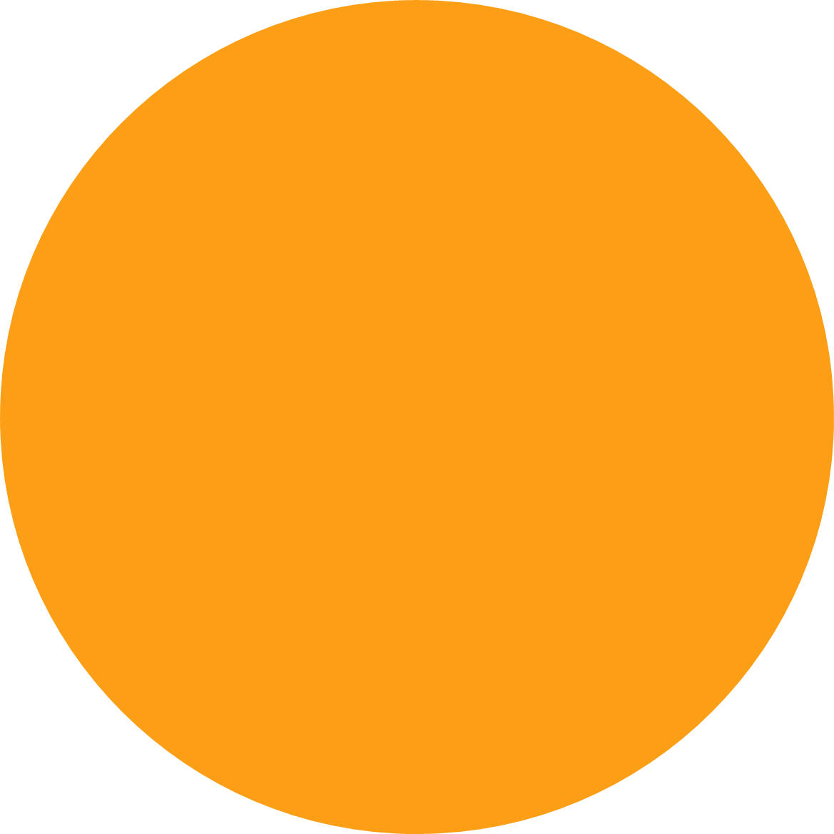
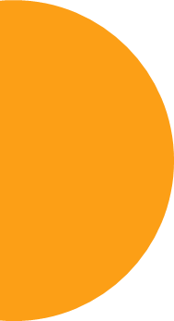
INTRODUCTION TO COMPUTER SCIENCE
Members:
Team 18
EN-000410 | Yilin Wang
EN-000445 | Rochan Khristi
EN-000447 | Simran Jotishi
EN-000314 | Chanakarn Charumalai
EN-000426 | Tilakkumar patel aka bhagat
Project Topic : Tic-Tac-Toe

Slide 2
The approach to solving it, challenges
The steps to build the Tic-Tac-Toe program in Python:
- Create the display window for our game.
- Draw the grid on the canvas where we will play Tic Tac Toe.
- Use labels to show which player’s turn is it and who wins the game. When someone wins the game or the game is a draw then we reset the game.
Challenges
We found that it was a challenging project for our team to write simple code and display the outcome precisely. We have developed the skills of writing code and team collaboration. Finally, our team completes the Tic-Tac-Toe game, and it works well.

Slide 3
Our teamwork, used version control and meetings
Our team divides the project into five tasks as follows: he project manager, developer, tester, slide maker, and speaker, and each person has to take action on one of them. We use the Jupyter notebook to create a file and upload it to GitHub for sharing with our team, including Trello to communicate our work. We arranged three meetings to discuss and complete the task.

Slide 4
Design idea & code explanation
Title: Tic Tac Toe Game
Language: Python
Tool : Jupyter Notebook
We have implemented a project on Tic Tac Toe GUI with Python. This game is very popular and is quite simple in itself. It is a two-player game. In this game, there is a board with 3×3 squares and a player marks one of the 3×3 squares with his symbol (perhaps “X” or “O”) and he aims to create a straight line horizontally or vertically or diagonally with two intentions one is to Create a straight line before your opponent to win the game or Prevent his opponent from creating a straight line first.
To implements this, we have used 9 buttons in a grid layout to make a 3x3 square and used labels and a message box to display messages. Then we have create a functions for button click, to check winner, to reset game, to disable buttons after win or tie game and quit button for closed game window.

Slide 5
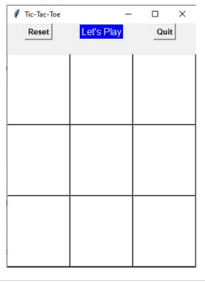
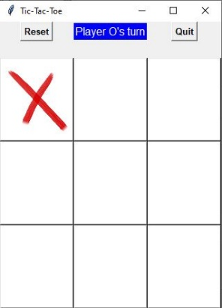
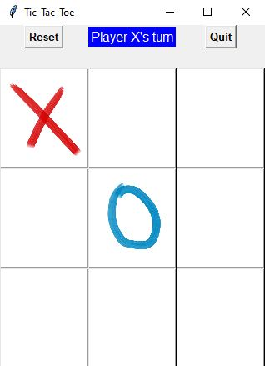
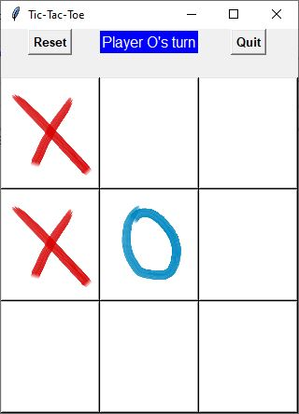
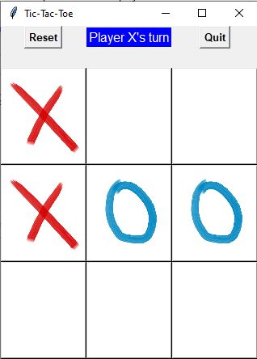
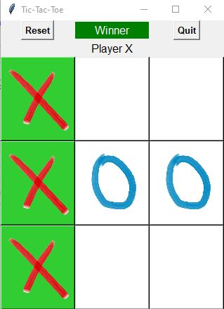
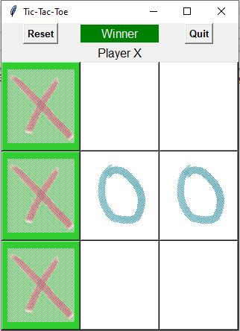
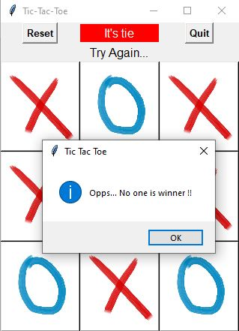
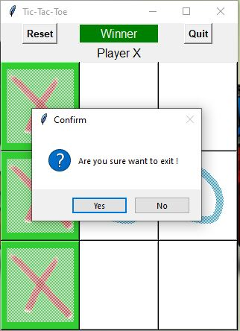
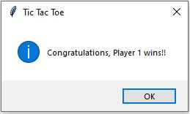
Achievement display
Tic-Tac-Toe Blank table
Player X start
Player O’s turn
Player X’s turn
Player O’s turn
Player X’s turn and player X win the game
All box disabled after win game
If “No one is the winner!!!” then show message
Click on quit button the exit game

Slide 6
Lessons Learned & Future Work
In the Python team project, we practiced programming concepts and techniques by developing Python projects with others. We have gained more experience which helped us develop skills that are useful in both academic and professional environments.
Because we are all beginners in python, we have completed the basic functions of the project this time. If we have the opportunity to learn more in the future, we hope to improve it, such as adding more features or enhancing the user interface.

Slide 7
Thank you！
Team 18

